Slide 1
In-service Teacher Education in Brazil: projects in UFSCar
ICME Survey Team Meeting University of Tsukuba – 13 February 2015
A contribution from Brazil:
Yuriko Yamamoto Baldin (yuriko@dm.ufscar.br)
Professor of Mathematics
Department of Mathematics – Universidade Federal de São Carlos

Slide 2
Fifth largest country in the world: ~8515,000 km²
Large social- economic differences between North and South

Slide 3
Quantitative Challenges
 | 1970 | 1980 | 2010 | 2014
Population | 93139000 | 121150500 | 190755799 | 202768500
In 30 years the population DOUBLED (!)
190,000 basic education schools; 1.389 million school teachers (1st to 9th grades)
By 2011, 30.5 million children enrolled in basic education system (1st to 9th grades, 6 to 14 years old) due to compulsory education regulation (inclusiveness and equity)
Rapid urbanization of bigger towns and cities does not support quality education,
enough school facilities, qualified teachers for ALL.
Migration phenomena to cities: Shortage of qualified teachers in many regions.

Slide 4
How to ensure Quality Education for All? (Qualitative Perspective)
Educate future teachers prepared to new era of communication world:
Modernization of curriculum: content, pedagogy and ICT competencies
Integration of Mathematics and Mathematics Education to bridge gaps of formation
Help in-service teachers in their professional development:
Paradigm shift in their classroom practices (Lesson Study principles),
Reinforcement of conten knowledge through Investigative Problem Solving
Pedagogical content knowledge for teaching, learning, assessment.

Slide 5
Challenging context of in-service teacher education (mathematics) in Brazil
The pre-service Teacher education courses present gaps:
The teachers for elementary I (1st to 5th grades, 6 to 10 years old) receive diploma from Pedagogy courses, with very little and conceptually weak mathematics content knowledge; pedagogical course units have theoretical approach and very little methodological practices, no studies about problem-solving steps and knowledge of effective assessment.
The teachers for elementary II (6th to 9th grades, 11 to 14 years old) can teach also for upper secondary level (10th to 12th grades, 15 to 17 years old), and get the diploma from Teacher Education Courses at tertiary level.
In the curriculum, higher mathematics course units, pedagogy courses like didactics and psychology with theoretical perspective, little connection with actual training in the classrooms.
Many practice trainings are remedy to the lack of teaching force at schools, without coaching/tutoring on content or methdology to deal with classroom dynamics.

Slide 6
Challenging context of in-service teacher education (mathematics) in Brazil
The pre-service Teacher education courses present gaps:
The teachers for elementary I (1st to 5th grades, 6 to 10 years old) receive diploma from, with very little and conceptually weak content knowledge in Pedagogy courses mathematics, pedagogical course units with theoretical approach and very little methodological practices, no studies about problem-solving steps and assessment.
The teachers for elementary II (6th to 9th grades, 11 to 14 years old) receive diploma to teach also for upper secondary level (10th to 12th grades, 15 to 17 years old), and get the diploma from Teacher Education Courses at tertiary level.
Higher mathematics course units, pedagogy courses as didactics and psychology under theoretical perspective with no connection to actual practice training.
Many practice trainings are mere remedy to the lack of teaching force of schools, with no coaching on content or methdology to deal with classroom dynamics.
SOLUTION?SO
SOLUTION?
PROBLEM SOLVING BASED LESSON STUDY!

Slide 7
Brazilian context that motivated my research projects with Lesson Study at UFSCar:
The lesson plan is not a collective activity in a school, especially in public schools;
The lessons are not either observed nor evaluated;
The textbooks and the oficial curriculum constitute real challenges to introduce adequate innovative activities into the social context of school and classrooms;
Lack of order/discipline inside classrooms as well as of previous knowledge of students;
Teachers without habits of reviewing and reflecting on own lessons;
The lesson is usually “given/lectured” by the teacher, and it is not “participated and learned” by all students during the lesson time.
The evaluation/assessment are limited to grading tests, not used to improve the learning or teaching.

Slide 8
Lesson Study and PROBLEM SOLVING Lesson Study Principles as strategy of Research Subject are essential to educate the perception of in-service teachers about the power of Problem Solving to improve the classroom activities: exploring, discovering, extending Mathematics through adequate inquiries
Problem solving is not just a methodology, it is mathematics activity to achieve the educational objectives

Slide 9
Lesson Study in Brazilian context
Reflection, Preparation: contents,
curricular objectives, classroom
Planning/posing problems and
questioning
Execute the plan, observe/ take notes about reactions and results
Critical reflection/evaluation

Slide 10
Lesson Study in Brazilian context
Problem Solving Steps
Reflection, Preparation: contents,
curricular objectives, classroom
Planning/posing problems and
questioning
Execute the plan, observe/ take notes about reactions and results
Critical reflection/evaluation

Slide 11
Problem Solving in participative learning
Students learn how to study and learn what is “to do mathematics activities”, they play active role in building knowledge, being critic with solutions and strategies;
Teachers learn how to teach changing the paradigm of classroom activities to active participation of students. Teachers consolidate the organized knowledge of mathematics required to conduct the mathematical thinking built by students.

Slide 12
International trend in Mathematics Education Research on The Professional Development for School Teachers (ICMI Study 15): Practice Based Professional Development - PBPD
Teachers become Researchers of their Practices, based on Mathematics Educational Theories and grounded in solid Mathematics Content Knowledge (Pedagogical Content Knowledge AND Mathematics Knowledge for Teaching).
The increasing perception of Math Educators about the research field of “teaching and learning Mathematics” with focus on the “practice in and for classroom activities”

Slide 13
Projects aligned to this research field:
PPGECE (Master Program for In service teachers) at UFSCar;
PROF-OBMEP (Special course for in service teachers aiming at a connection among topics of mathematics and the teachers’ knowledge, and a paradigm shift in the attitude of teachers and students in a problem solving lesson → original research on the development of didactical material with the use of innovative and challenging problems (Baldin & Silva, 2012~to date)
Inspiration and influences from Lesson Study - Japan, Singapore approach to elementary mathematics concepts and pictorial model for problem solving.

Slide 14
Graduate Program in Teaching Mathematics (case of UFSCar: Master degree)
Target public : School Teachers (6th to 9th grades, 10th to 12th)
2 year(+1) program;
Basic thematic research subjects: Content and Experiments in Teaching Mathematics; ICT in Teaching Mathematics
Curriculum composed by:
Mathematics Course Units (Geometry, Real Analysis for Teachers, Number Theory and Algebraic Structures, Linear Algebra, Mathematics Modeling, History of Mathematics, ICT in Teaching and Learning Mathematics),
Educational Course Units;
Master Dissertation (Innovative Classroom Practice; Development of innovative teaching material; Development of Digital Educational Object…)

Slide 15
Main principles of professional development course for in-service teachers PROF-OBMEP
Participant teachers experiment themselves each step of problem-solving activity to learn what is important to know to make a lesson plan based on student centered problem solving:
Through inquiry (what to ask, how to ask, why to ask), discovery (what, for what), planning a strategy (need of conceptual knowledge and creativity), execution of plan (need of techincal skills), exploring (validation, generalization/extensions, consolidation of the learned knowledge). Influence of Lesson Study principles, Japanese and Singapore approaches in textbooks.
Reflection about the learning by teachers on own attitude during a lesson, about deeper meaning of assessment that goes beyond the grading but includes the dqualitative analysis of the types of students’ errors to convey new lesson plans.
Analysis of the didactical materials used in the schools (textbooks, working sheets, evaluation tests) and overall curriculum issues, in order to understand the flow of teaching and learning across the grades.
Use of challenging problems NOT in textbooks in order to learn how to connect and transform them to school curriculum.
Learn to explore open-ended approach.

Slide 16
The structure of the program PROF-OBMEP
4 modules (100 hours each) of presential hands-on workshops (60 hours) along with monitoring and coaching through virtual platforms between the sessions.
Mandatory task of planning a problem-solving based lessons, execution in the schools, bringing the oucomes for discussion, poster presentation of final results. (Lesson Study)
In presential sessions, participant teachers must solve the proposed problems disclosing and justifying every step of problem-solving and then discuss the school curriculum related to each problem and the competencies worked out in it.
The virtual platform support teachers by offering, besides on-line discussions, teaching materials, texts as well as suggestions of educational sites.
Supervision of practices in the schools and orientation to the pedagogical use of ICT by researchers/educators.

Slide 17
Expanding Lesson Study in Brazil (slow but promising...)
An independent group of study in a region of the State of São Paulo: former teacher researchers of PROF-OBMEP acting as local leaders to introduce problem-solving Lesson Study into 5 schools, ~12 teachers;
Graduate Programs of Mathematics Education at UFRJ (Rio de Janeiro) and UERJ (Rio de Janeiro) are now developing research projects on Lesson Study, Master degree level.
HOPING to expand the network of collaborations with international help!

Slide 18
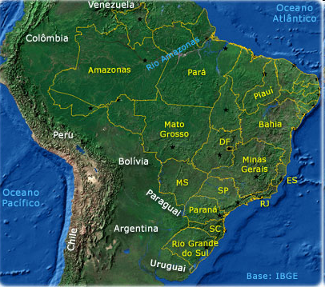
Some places in which the Brazilian projects (UFSCar) have been worked out

Slide 19
One discontinued professional professional development project
PRO LETRAMENTO (literacy) in Mathematics for primary school level:
2006 – 2009 (and then?)
Cascade style: almost 150,000 teachers ( tutoring directly inside schools)
Development of teaching material for teachers to learn the subject content knowledge and to bring to the classrooms with mehdological orientation
BUT...

Slide 20
A concrete manipulative for lessons about fractions (PPGECE-UFSCar)

Slide 21
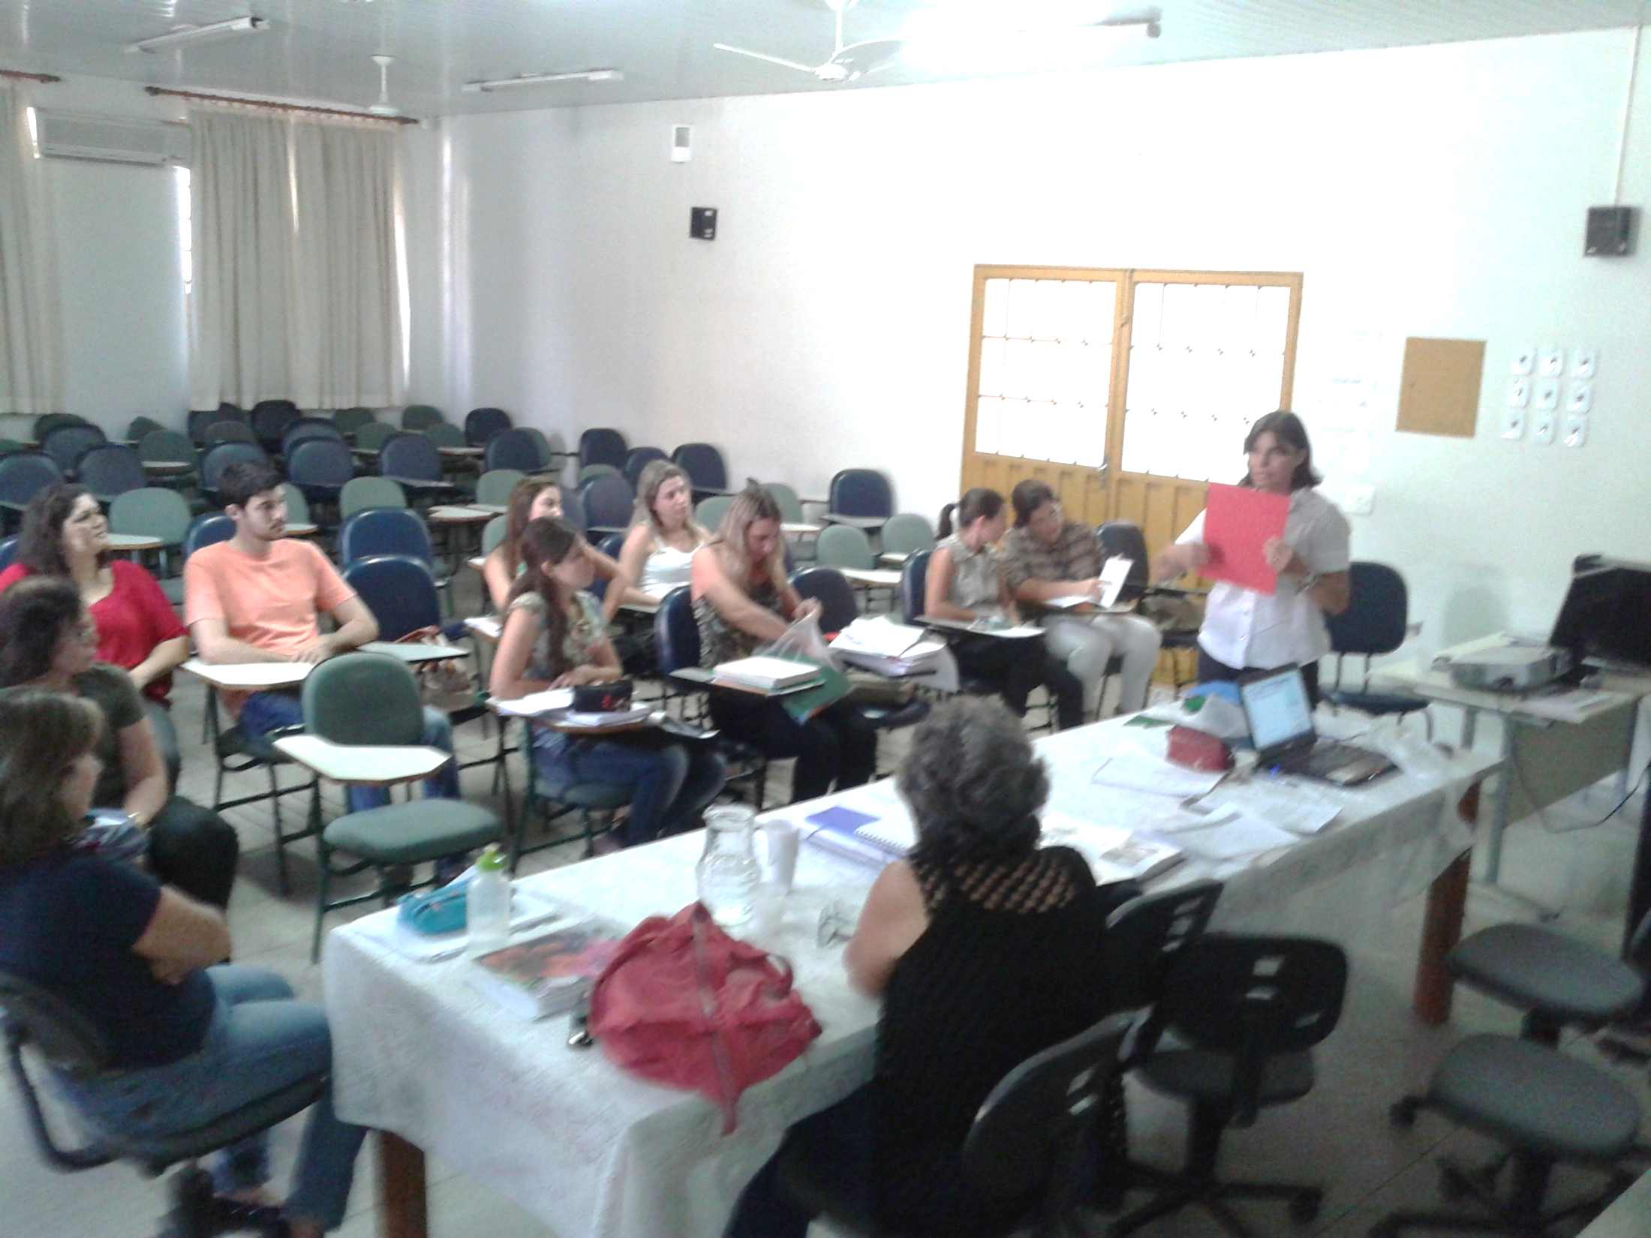
Preparatory discussion, before lesson: contents, methodology, beliefs (2014)

Slide 22
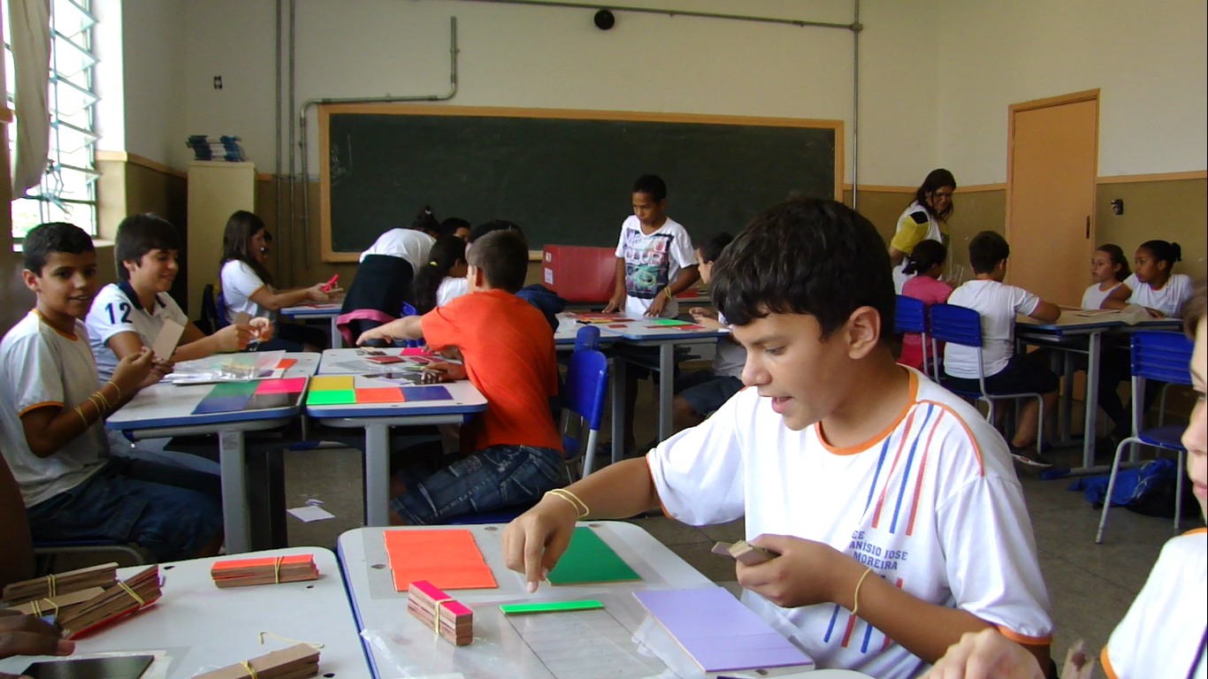

Slide 23
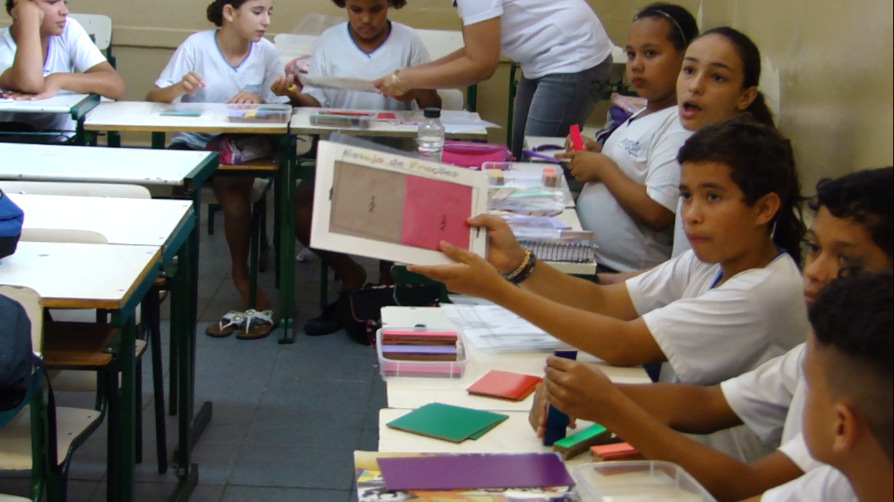

Slide 24
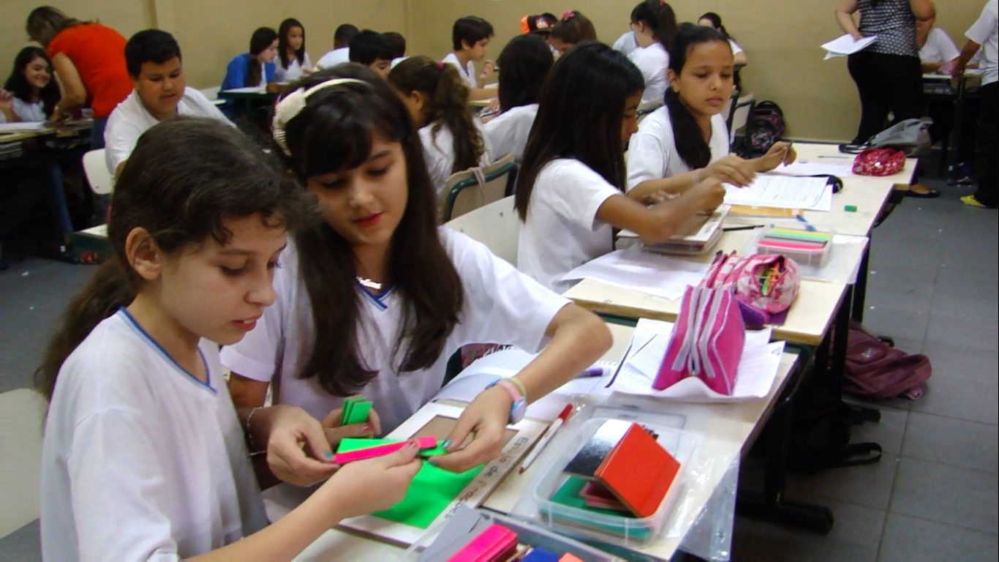

Slide 25
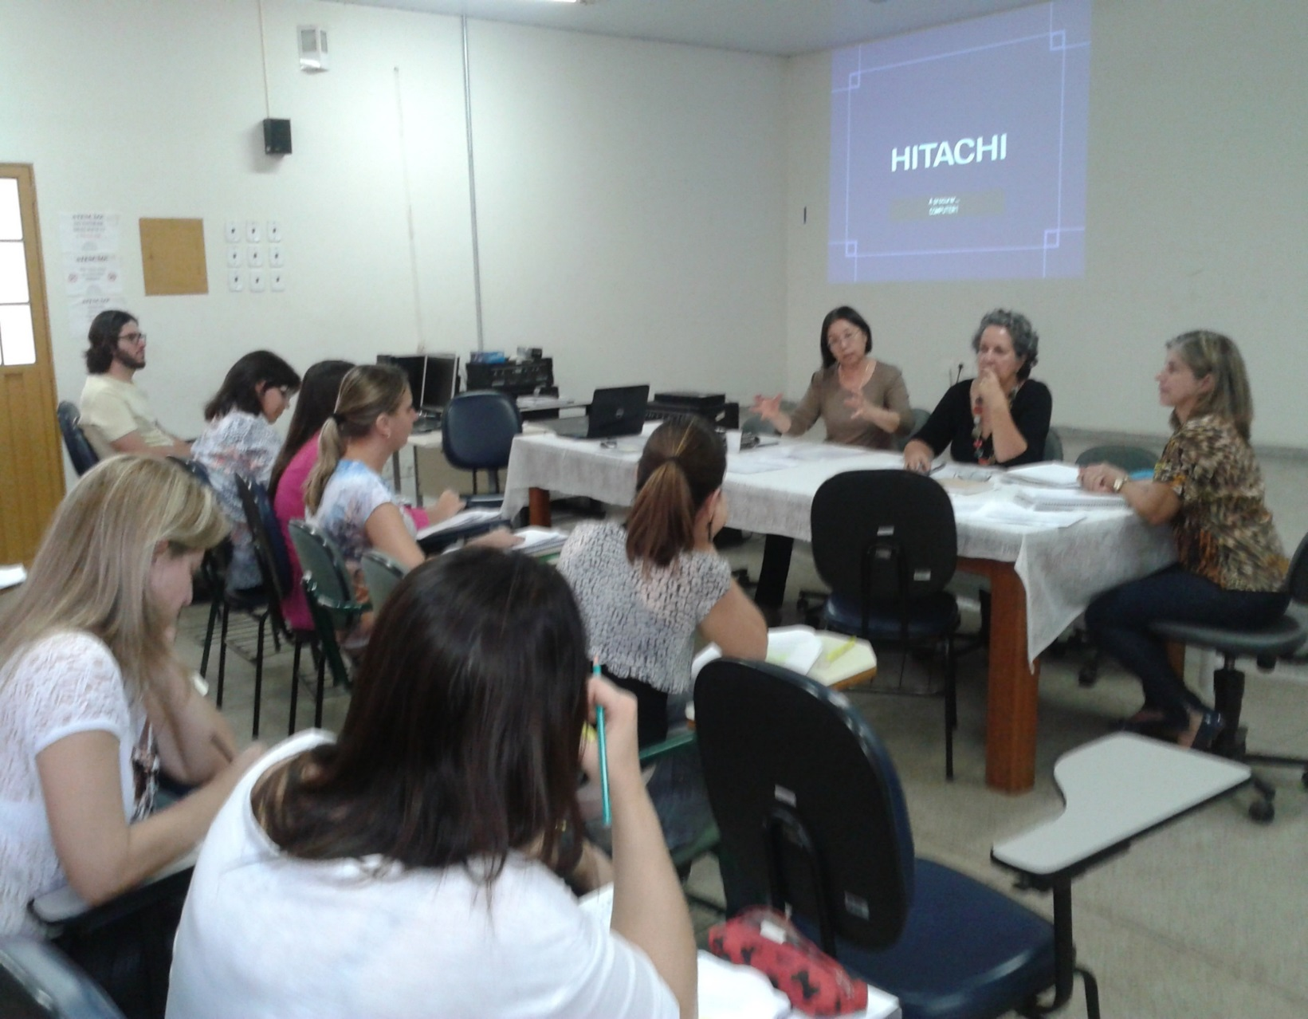
Discussion after the report on the lesson(2014)

Slide 26
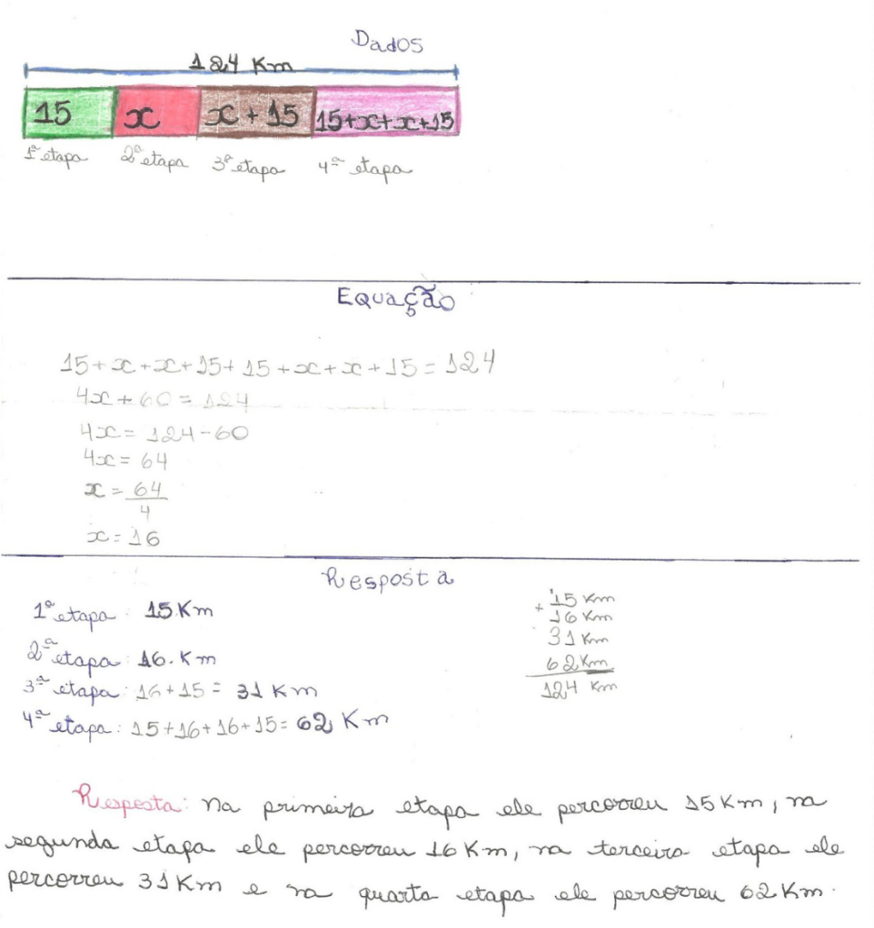
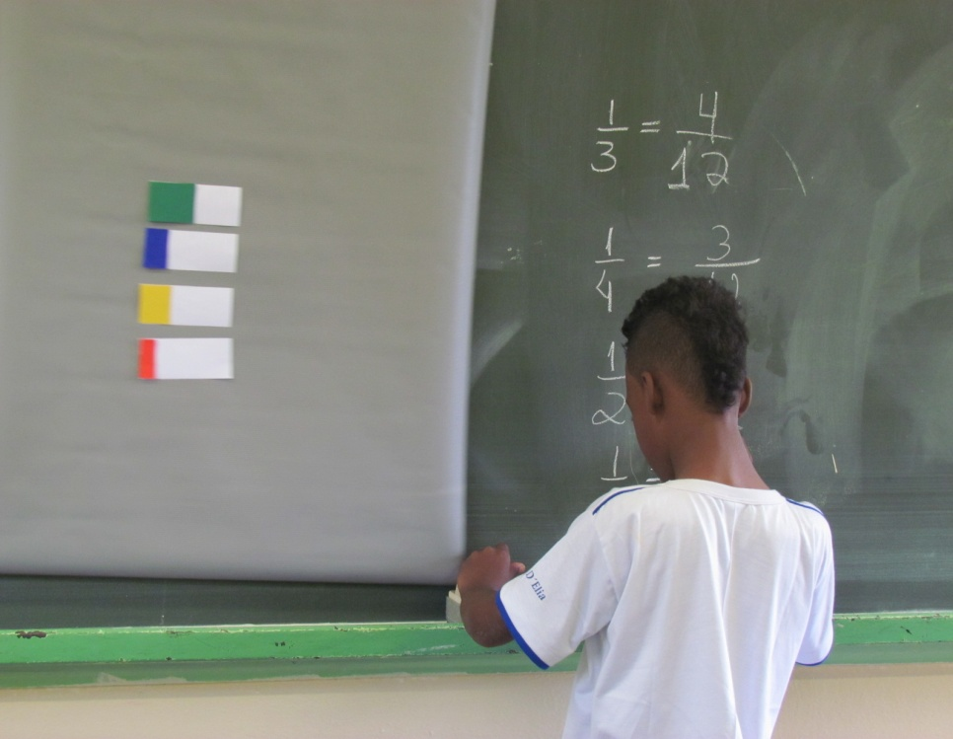
From classroom practices (PPGECE): problem solving, lesson study principles, bar model from Singapore Mathematics, (Campinas, SP)
HAPPY to include a student !
Franca, SP

Slide 27
A sequence of Lesson Study for 8th grade classrooms, a School Project with GC (Ribeirão Preto, SP): 1- Preparing session: study and discussion with teachers

Slide 28
2-Training session and pilot experimentation with assistant-students

Slide 29
3- Classroom activity (Ribeirão Preto)

Slide 30
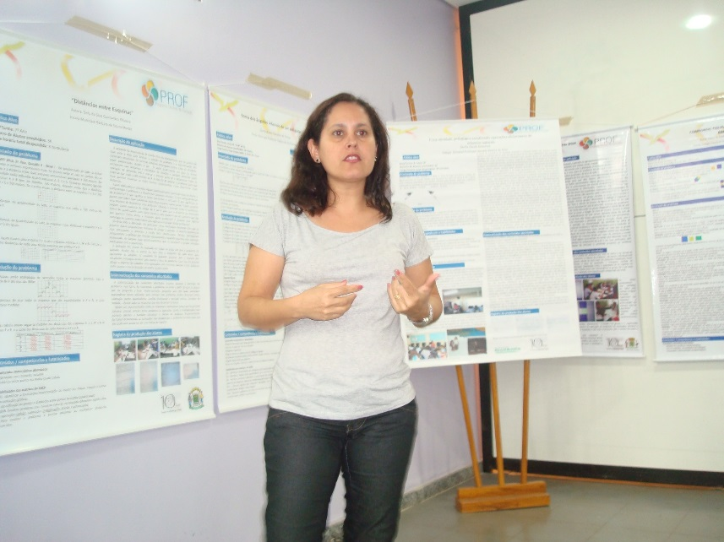
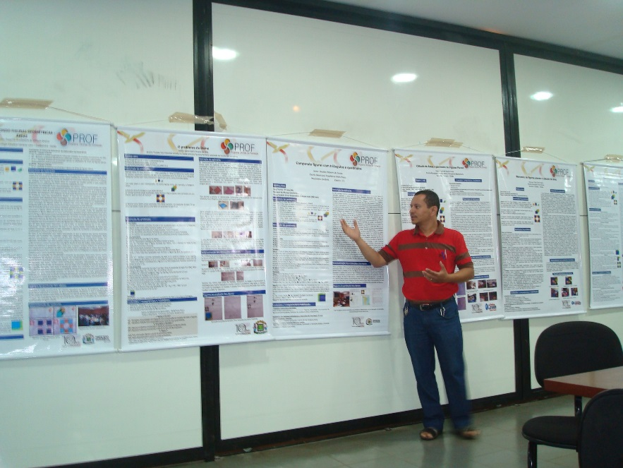
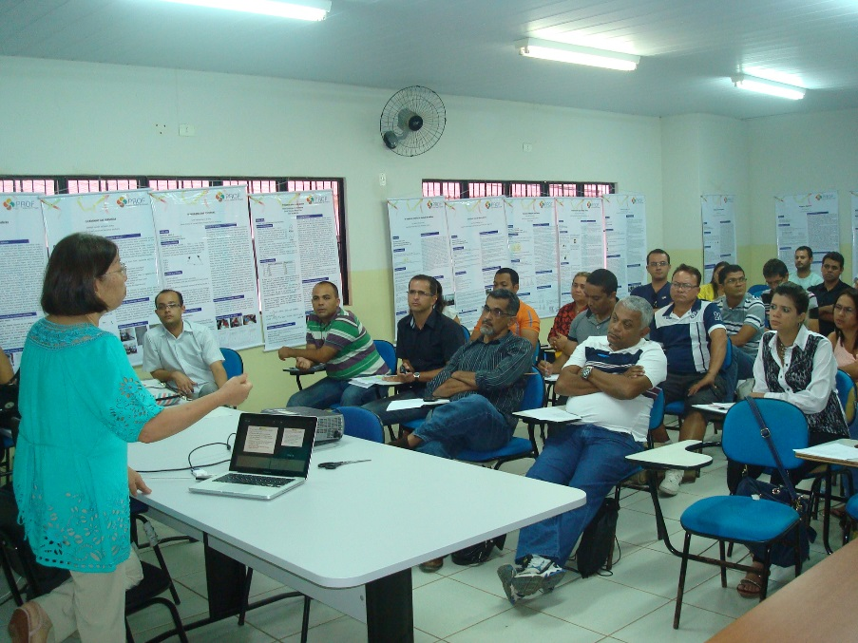
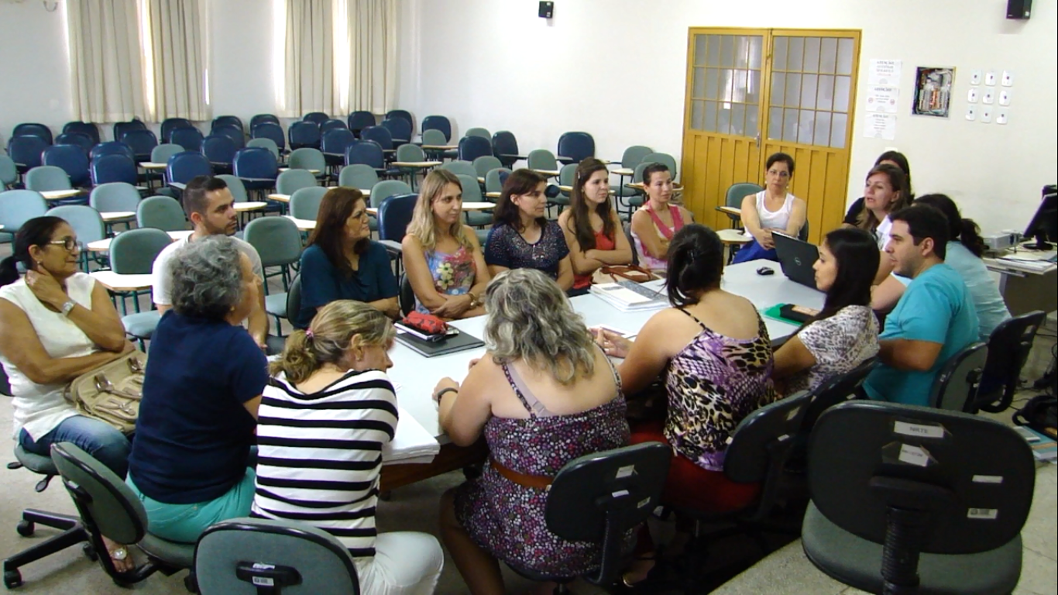

Slide 31
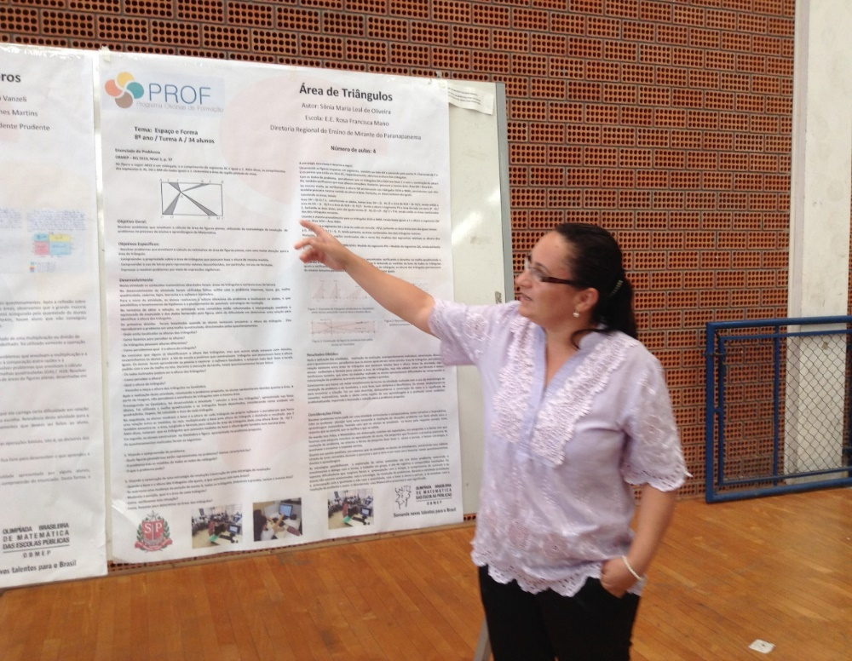
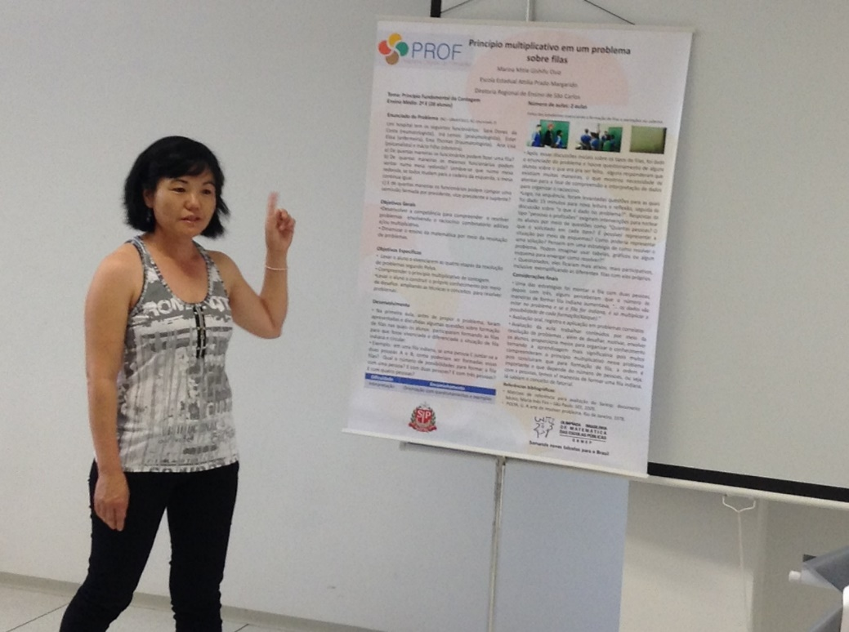
Poster Presentation of results of the project PROF-OBMEP: Group discussion, Exchange of experiences, New ideas, Growing confidence (2013 and currently). Trying to pursue the model of true Lesson Study!

Slide 32
Conclusion
Countries with different historical, social and cultural backgrounds can collaborate to learn from each other for good experiences to overcome the complex problems of mathematics education of teachers.
The mission of teacher educators and researchers of teaching mathematics should be focused in providing opportunity to everybody to achieve mathematics literacy through problem solving.
Lesson Study is grounding methodology to stimulate teachers to become better teachers and researchers of own practice.

Slide 33
Thank you very much for your attention!

